Slide 1



Spotify
Trend Analysis
By Rajadurai DJ
Notes:
<a href="https://www.freepik.com/free-photo/lifestyle-summer-holidays-technology-concept-carefree-happy-handsome-man-close-eyes-feeling-pleased-listening-favorite-song-wireless-headphones-feel-satisfaction-perfect-sound_17118229.htm#query=hearing%20music&position=5&from_view=search">Image by benzoix</a> on Freepik

Slide 2



Yourwebsite.com
Project About:
About Us
Thorough investigation using the Spotify dataset and an in-depth analysis were
conducted. in information. Additionally, demonstrating how the data interacts with
one another across Popularity by track name, state, nation, and popularity by country.
and which nation held a higher status within it.
Our Album
Playlist
Artists
Podcasts & Shows
Your Library
Trending
Help
Report History
Notes:
Photo by Frank Septillion on Unsplash

Slide 3
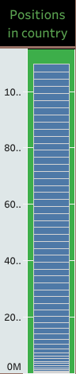
Yourwebsite.com
Positions in Country:
About Us
Among this many countries france has more positions with more
Than 25.8 Lakh and turkey, Germany list in 2nd and 3rd.
More positions was highlighted in European countries.
Our Album
Playlist
Artists
Podcasts & Shows
Your Library
Trending
Help
Report History
Notes:
Photo by Frank Septillion on Unsplash

Slide 4
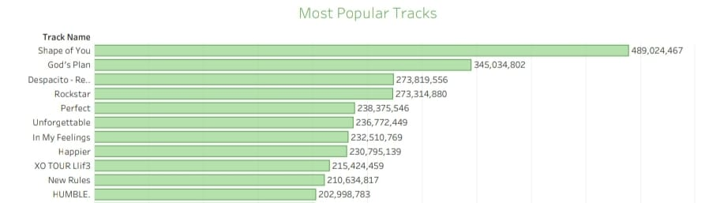
Yourwebsite.com
Most Popular Tracks
About Us
Our Album
Playlist
Artists
Podcasts & Shows
Your Library
Shape of you has a outcome with good response more than 48M and others tracks like
Gods plan and despacito lists in 2nd and 3rd.
This Shape of you song were streamed more in USA.
Particularily In the Year of 2017
More than 4k positions were reflected
Trending
Help
Report History
Notes:
Photo by Frank Septillion on Unsplash

Slide 5
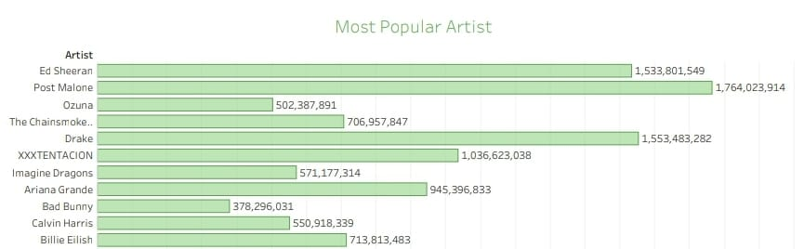
Yourwebsite.com
Most Popular Artist:
About Us
Our Album
Playlist
Artists
Podcasts & Shows
Your Library
The above graph shows that post Malone & Ed Sheeran is the famous artist over all
Compare to other countries Ed sheeran album makes more numbers in USA
More than 9M streams happen over in 2017
The number of positions reflects more than 20k
Trending
Help
Report History
Notes:
Photo by Frank Septillion on Unsplash

Slide 6
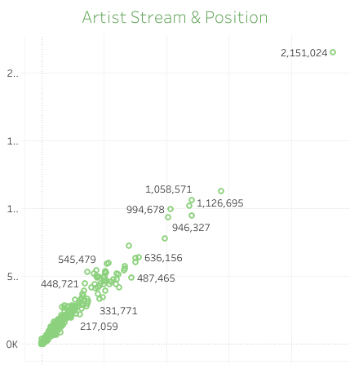
Yourwebsite.com
Artist Stream & position:
About Us
Our Album
Playlist
By Position and stream wise ed sheeran hits more reach compare to other artist
And post Malone takes with second place
Artists
Podcasts & Shows
Your Library
Trending
Help
Report History
Notes:
Photo by Frank Septillion on Unsplash

Slide 7
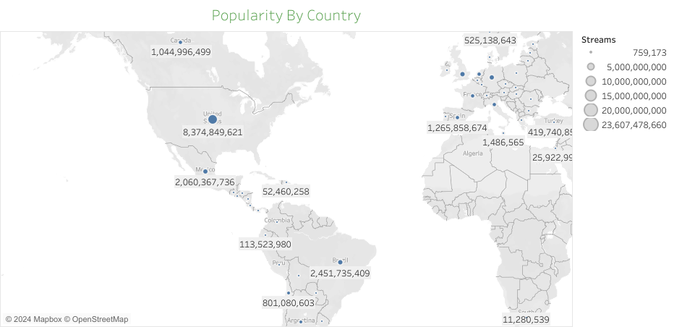
Yourwebsite.com
Popularity By Country:
About Us
Our Album
Playlist
Artists
Podcasts & Shows
Your Library
Trending
USA is the first country streams more numbers of songs
Artist Post Malone albums plays more number in USA
In the year 2018 USA hits more number compare to 2016 & 2017
Help
Report History
Notes:
Photo by Frank Septillion on Unsplash

Slide 8
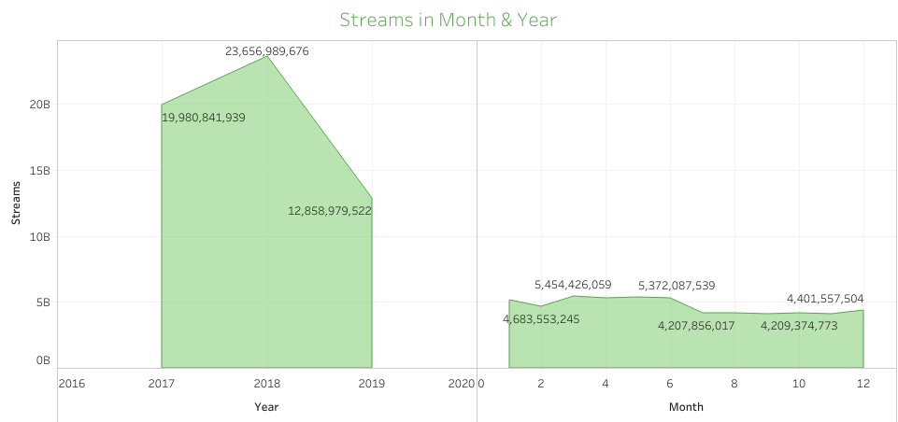
Yourwebsite.com
Streams in Month & Year
About Us
Our Album
Playlist
Artists
Podcasts & Shows
Your Library
Trending
Help
More streams has been performed in 2018
In the month of 3,4,5 has more streams
Report History
Notes:
Photo by Frank Septillion on Unsplash

Slide 9

Thank You

